Slide 1
C# Introduction
Day 2

Slide 2
Guide to Visual Studio

Slide 3
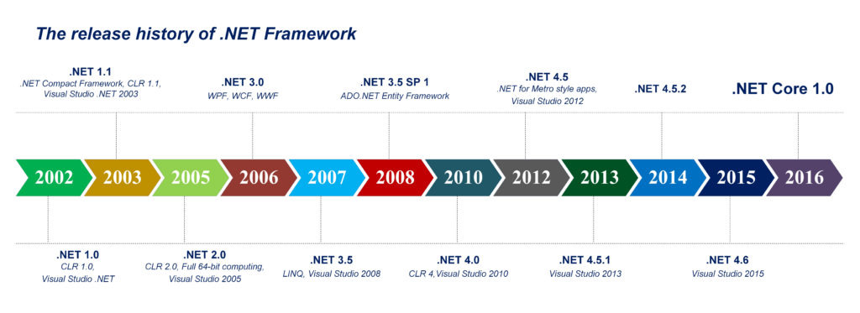
.Net Version Comparison

Slide 4
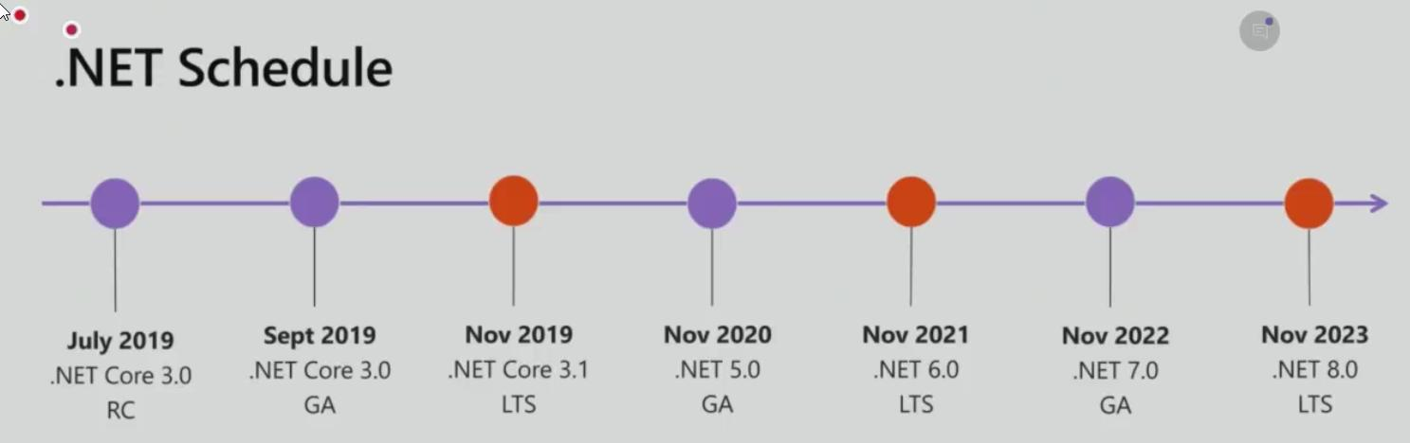

Slide 5
Multi Language Support in .Net
We can have multiple startups
.net framework and .net programming language are different
Console.writeline is a library inside the inside .net framework

Slide 6
Differences between .Net Framework and .Net Core

Slide 7
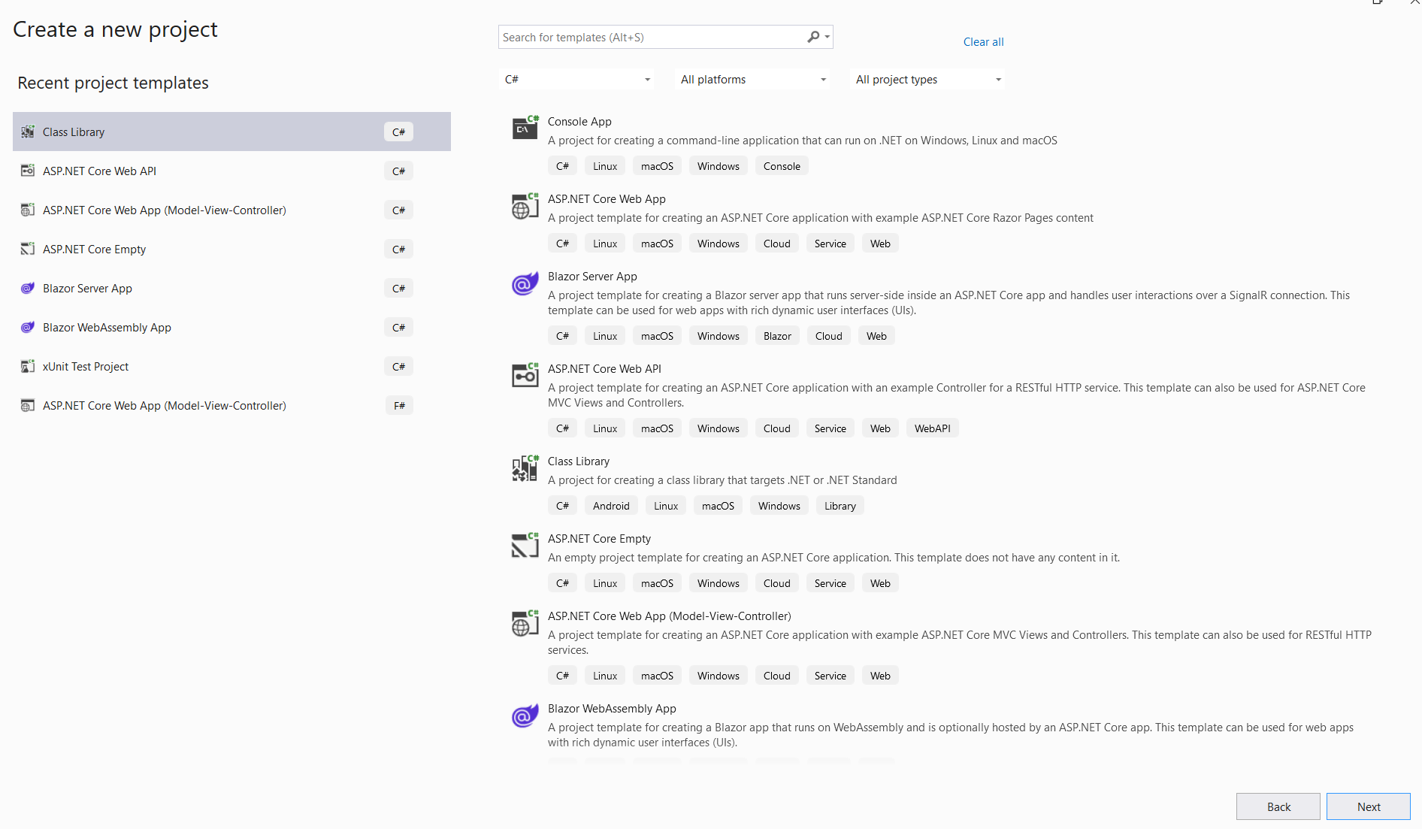
Console Application

Slide 8
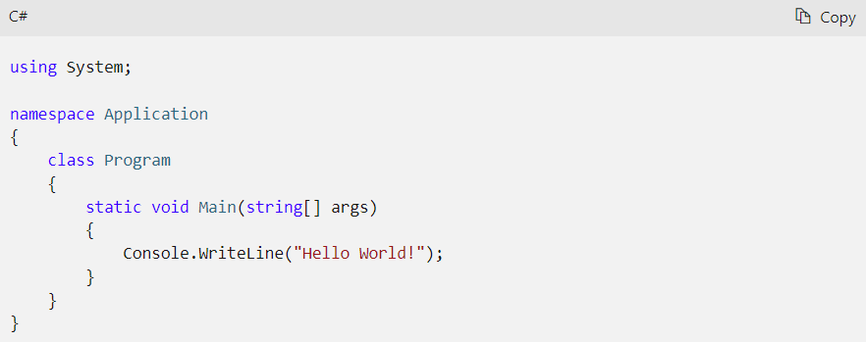
Top Level Statements
Without Top Level Statements

Slide 9
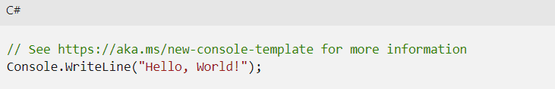
Top Level Statements
Top Level Statements
Top-level statements enable us to avoid the extra ceremony required by placing your program's entry point in a static method in a class

Slide 10
Benefits of Using C# Language
Versatility
Object Oriented Programming
Cross Platform Development
Extensive Frameworks and Libraries
Strong Community Support
Career Opportunities

Slide 11
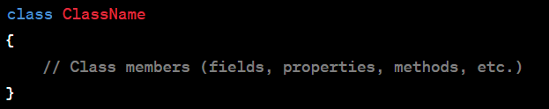
Basic Syntax
Namespace Declaration:
A C# program starts with a namespace declaration, which provides a way to organize code.
Syntax: namespace YourNamespaceName { }
For top-level statements, namespace YourNaespaceName;
2. Class Declaration:
Inside the namespace, you define classes, which are the fundamental building blocks of C# programs.

Slide 12
Basic Syntax
3. Main Method:
Every C# program requires a Main method, which serves as the entry point of the program.
static void Main(string[] args)
{
// Program statements
}

Slide 13
Basic Syntax
Comments:
Comments are used to document code and improve its readability. They are not executed by the compiler.
// Single-line comment
/*
Multi-line
comment
*/

Slide 14
Basic Syntax
Variables and Data Types:
Variables are used to store and manipulate data. In C#, you need to declare variables before using them.
Syntax: dataType variableName;
Example: int age;

Slide 15
Basic Syntax
Assigning Values to Variables:
To assign a value to a variable, use the assignment operator (=).
Syntax: variableName = value;
Example: age = 25;
2. Basic Data Types:
C# provides various data types, such as int, float, double, bool, string, etc.
Example: int count = 10;, float pi = 3.14f;, string name = "John";

Slide 16
Basic Syntax
Console Output:
You can display output to the console using the Console.WriteLine() method.
Syntax: Console.WriteLine("Your message");
Console Input:
You can read input from the console using the Console.ReadLine() method.
Syntax: string input = Console.ReadLine();
Control Flow:
C# provides various control flow statements for decision-making and looping, such as if, else, switch, for, while, etc.
Example:

Slide 17
Syntax for Running Dotnet Console
Dotnet new
Dotnet restore
Dotnet build
Dotnet run

Slide 18
Structure
Namespace
Class
One or more methods
Scope is defined between the curly braces.

Slide 19
Variable and Data Types
Variables are used to store and manipulate data in C# programs.
They have a data type that determines the kind of data they can hold.

Slide 20
Common Data Types
int: Used for storing whole numbers (e.g., 10, -5, 0).
float: Used for storing single-precision floating-point numbers (e.g., 3.14f).
double: Used for storing double-precision floating-point numbers (e.g., 3.14).
bool: Used for storing boolean values (either true or false).
string: Used for storing sequences of characters (e.g., "Hello, World!").

Slide 21
Variable Declaration and Initialization
Syntax: dataType variableName = value;
Examples:
int age = 25;
float pi = 3.14f;
bool isStudent = true;
string name = "John Smith";

Slide 22
Variable Naming Rules
Variable names must start with a letter or underscore and can include letters, digits, and underscores.
They are case-sensitive, so "count" and "Count" are treated as different variables.
Choose meaningful and descriptive names for variables to improve code readability.

Slide 23
Variable Scope
The scope of a variable determines where it can be accessed within the program.
Variables declared inside a method or block are typically local to that scope.
Global variables can be accessed from anywhere in the program.

Slide 24
Type Inference with var
C# supports type inference using the var keyword.
The compiler automatically determines the variable's type based on the assigned value.
Example: var x = 10; (The compiler infers x as an int.)

Slide 25
Introduction to Control Flow
Control flow statements allow you to control the execution flow of your program.
They determine which sections of code are executed and under what conditions.

Slide 26
Conditional Statements
if Statement:
Syntax: if (condition)
Executes a block of code if the condition is true.
else Statement:
Syntax: else
Executes a block of code if the previous condition(s) in an if statement are false.
else if Statement:
Syntax: else if (condition)
Executes a block of code if a different condition is true.

Slide 27
Example
int age = 18;
if (age >= 18)
{
Console.WriteLine("You are eligible to vote.");
}
else
{
Console.WriteLine("You are not eligible to vote.");
}

Slide 28
Loops
for Loop:
Syntax: for (initialization; condition; iteration)
Repeatedly executes a block of code while the condition is true.
while Loop:
Syntax: while (condition)
Executes a block of code as long as the condition is true.
do-while Loop:
Syntax: do { } while (condition)
Executes a block of code at least once and then repeatedly as long as the condition is true.

Slide 29
Switch Statement
Syntax: switch (expression)
Executes a block of code based on the value of the expression.
Uses case labels to match specific values.
Includes a default case for handling unmatched values.

Slide 30
Example of Switch Statement
int day = 3;
switch (day)
{
case 1:
Console.WriteLine("Monday");
break;
case 2:
Console.WriteLine("Tuesday");
break;
case 3:
Console.WriteLine("Wednesday");
break;
default:
Console.WriteLine("Invalid day");
break;
}

Slide 31
Dll and Class Library
Assembly, Exe and Dll
Dynamic Link Library
Shared Logic - Class Library
Dll
Exe files gets executed by themselves whereas dll files gets executed by other appl console, web
Class library
Add reference
Assembly - final unit of deployment final thing that we take to the end user while deployment

Slide 32
Arrays and Collections

Slide 33
Introduction to Arrays
Arrays allow you to store multiple values of the same data type in a single variable.
They provide a way to work with a collection of elements.

Slide 34
Declaring and Initializing Arrays
Syntax: dataType[] arrayName = new dataType[length];
int[] numbers = new int[5];
numbers[0] = 1;
numbers[1] = 2;
// ...
numbers[4] = 5;

Slide 35
Accessing Array Elements
Elements in an array are accessed using their index.
Indexing starts from 0 and goes up to length-1.
Example: int firstNumber = numbers[0];

Slide 36
Array and Length Property
Arrays and Length Property:
The length of an array is determined by its "Length" property.
Example: int arrayLength = numbers.Length;

Slide 37
Introduction to Collections
Collections are built-in classes that provide more flexibility and functionality than arrays.
They can dynamically grow or shrink in size and have various methods for manipulation.

Slide 38
Common Collections in C#
List<T>: Represents a dynamic list of elements.
Dictionary<TKey, TValue>: Represents a collection of key-value pairs.
HashSet<T>: Represents a set of unique elements.
Queue<T>: Represents a first-in, first-out (FIFO) collection of elements.
Stack<T>: Represents a last-in, first-out (LIFO) collection of elements.

Slide 39
Working with Lists
Lists provide methods for adding, removing, and accessing elements.
List<int> numbers = new List<int>();
numbers.Add(1);
numbers.Add(2);
// ...
numbers.Remove(2);
int firstNumber = numbers[0];

Slide 40
Working with Dictionaries:
Dictionaries store key-value pairs.
Keys must be unique within the dictionary.
Dictionary<string, int> ages = new Dictionary<string, int>();
ages.Add("John", 25);
ages.Add("Alice", 30);
// ...
int johnAge = ages["John"];

Slide 41
Additional Collections
Mention other collections briefly, such as HashSet<T>, Queue<T>, and Stack<T>.

Slide 42
Functions and Methods
Functions (or methods) are blocks of code that perform a specific task.
They provide modularity and reusability in your programs.

Slide 43
Declaration and Syntax
Syntax: accessModifier returnType FunctionName(ParameterList)
public int Add(int a, int b)
{
int sum = a + b;
return sum;
}

Slide 44
Return Type and Parameters:
Return Type:
Specifies the type of value the function returns.
Examples: void (no return value), int, string, etc.
Parameters:
Inputs to the function.
Example: int a, int b in the previous example.

Slide 45
Calling Functions
Functions are called (or invoked) by their name followed by parentheses.
int result = Add(3, 5);

Slide 46
Void Functions
Functions with a return type of void do not return a value.
They are used for performing actions without returning a result.
public void DisplayMessage(string message)
{
Console.WriteLine(message);
}

Slide 47
Method Overloading
Method overloading allows you to define multiple methods with the same name but different parameter lists
public int Add(int a, int b)
{
return a + b;
}
public double Add(double a, double b)
{
return a + b;
}

Slide 48
Pass-by-Value vs. Pass-by-Reference:
Pass-by-Value vs. Pass-by-Reference:
By default, C# uses pass-by-value, which means a copy of the variable is passed to the function.
Use the ref or out keyword to pass variables by reference.
public void ModifyNumber(ref int number)
{
number += 10;
}

Slide 49
Scope of Variable
Variables declared inside a function are typically local to that function.
They are not accessible outside the function.
Example: Variables sum and result in the earlier examples.

Slide 50
Exception Handling in C#
Exception handling allows you to gracefully handle errors and exceptions that occur during program execution.
It helps prevent program crashes and provides a way to recover from unexpected situations.
C# provides various types of exceptions, such as:
System.Exception (base class for all exceptions)
System.NullReferenceException
System.IndexOutOfRangeException
System.DivideByZeroException
...and many more

Slide 51
Try-catch statement
try
{
// Block of code to try
}
catch (Exception e)
{
// Block of code to handle errors
}

Slide 52
Example
try
{
int[] myNumbers = {1, 2, 3};
Console.WriteLine(myNumbers[10]);
}
catch (Exception e)
{
Console.WriteLine(e.Message);
}

Slide 53
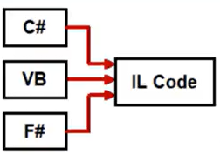
Differences between Debug and Release
VB C# compile into Il code intermediate language code
.net compiles to a common type system int32 il code ma cts
Cls compliance rules
cls
c# language is case sensitive
Vb .net is case insensitive
VB/C# Common type

Slide 54
Assignment
Install the Git
Create a console app via terminal and push that in github public repository

